Slide 2




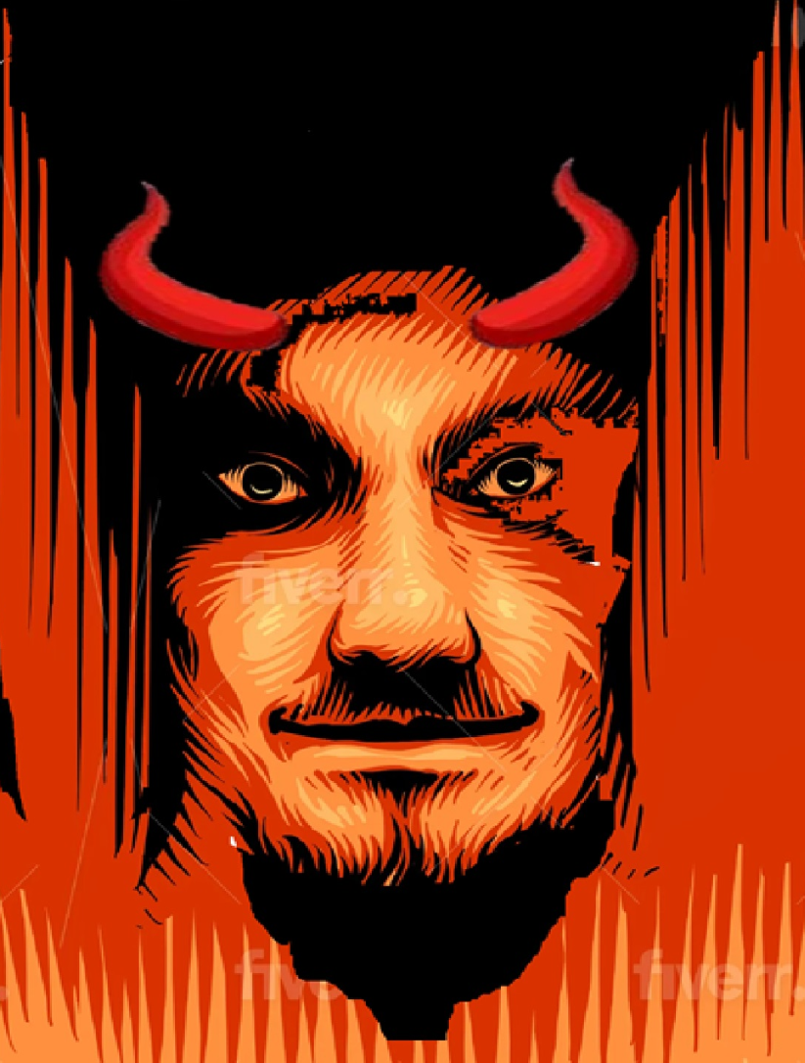

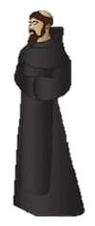

The White Abbott
A spoof is a funny version of something, like a movie or a book. The classic comedy "Young Frankenstein" is a spoof.
By J D Wills
This is story about how a practical joke turned in to a nightmare Horror
The White Abbott
This is story about how a practical joke turned in to a nightmare it's set in a small village and a nearby monastery.
This is a mystery Horror Story with a very surprised ending if you like a story that keeps you on the edge of your seat that twists and Turns and is it real or not this is the story for you from the author JD. Wills ….
By J D Wills
The Joke

Slide 3
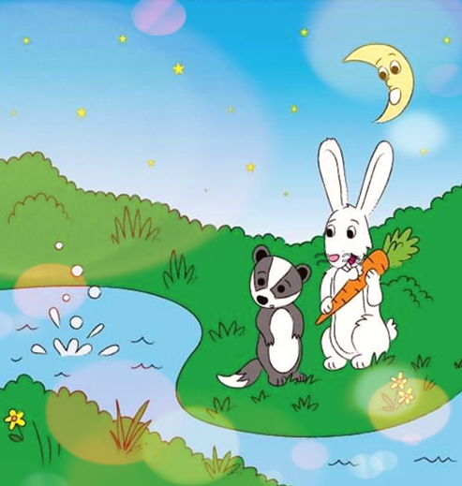


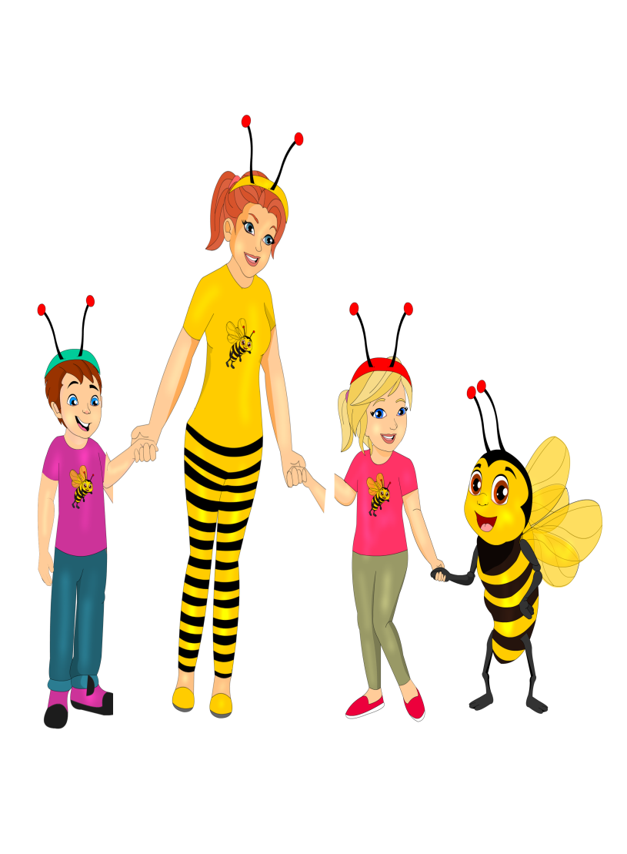

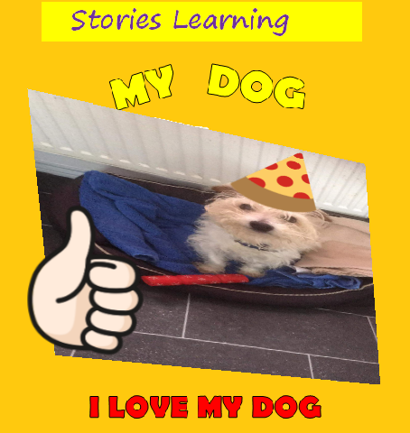










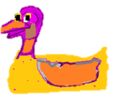
MY BOOK S
Badger and Rabbit looked over the pond and saw an orange and purple glow. "Who's there?” said Badger "Its me star! Can you help me please?”
Badger and Rabbit looked over the pond
and saw an orange and purple glow.
“Who’s there?” said Badger "Its me star! Can you help me please?”
This is story about how a practical joke turned in to a nightmare it's set in a small village and a nearby monastery.
This is a mystery Horror Story with a very surprised ending if you like a story that keeps you on the edge of your seat that twists and Turns and is it real or not this is the story for you from the author JD. WillsThis is story about how a practical joke turned in to a nightmare it's set in a small village and a nearby monastery.
This is a mystery Horror Story with a very surprised ending if you like a story that keeps you on the edge of your seat that twists and Turns and is it real or not this is the story for you from the author JD. WillsThis is story about how a practical joke turned in to a nightmare it's set in a small village and a nearby m….
….
….
Oscar
Oscars Hat
MY BOOK S
MY DOG

Slide 4


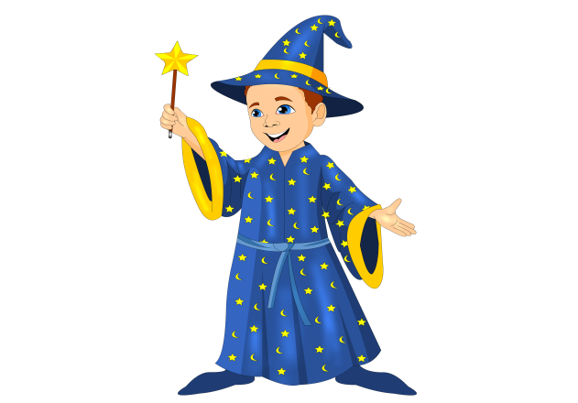
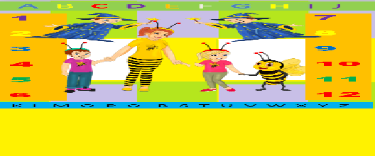
A B C D E F G H I J
1
2
3
4
5
6
7
8
9
10
11
12
A B C D E F G H I J
1 2 3 4 5 6 7 8 I9 10
MY BOOK S
K L M O P Q R S T U V W X Y Z

